Slide 1


Preprint

Slide 2


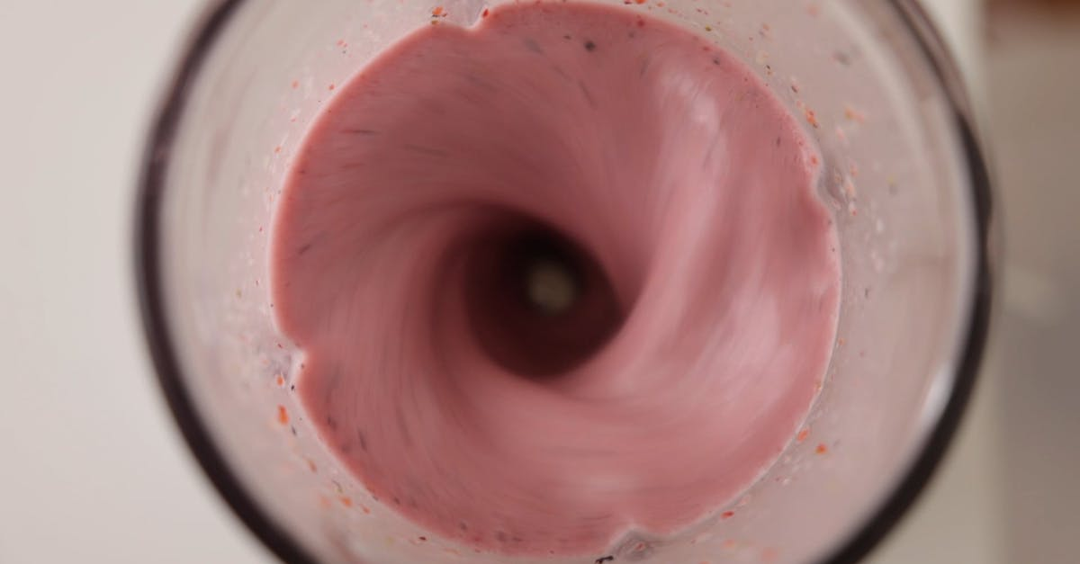
Inadequate analogy
Bulk RNA-seq
scRNA-seq
Spatial transcriptomics

Slide 3
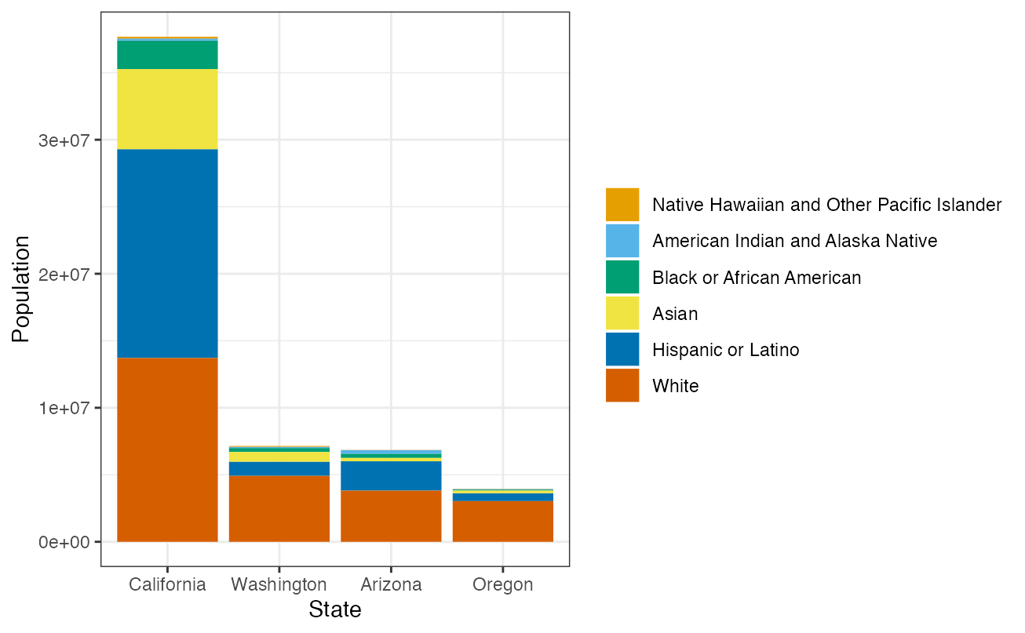
A geospatial analogy: bulk RNA-seq

Slide 4
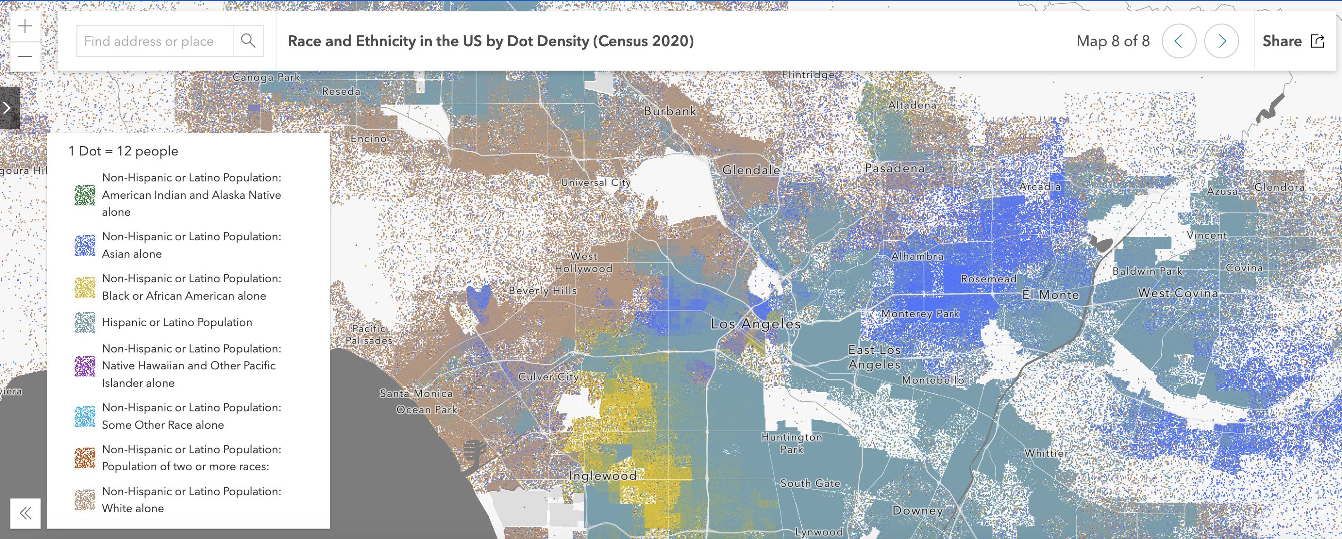
A geospatial analogy: spatial transcriptomics

Slide 5
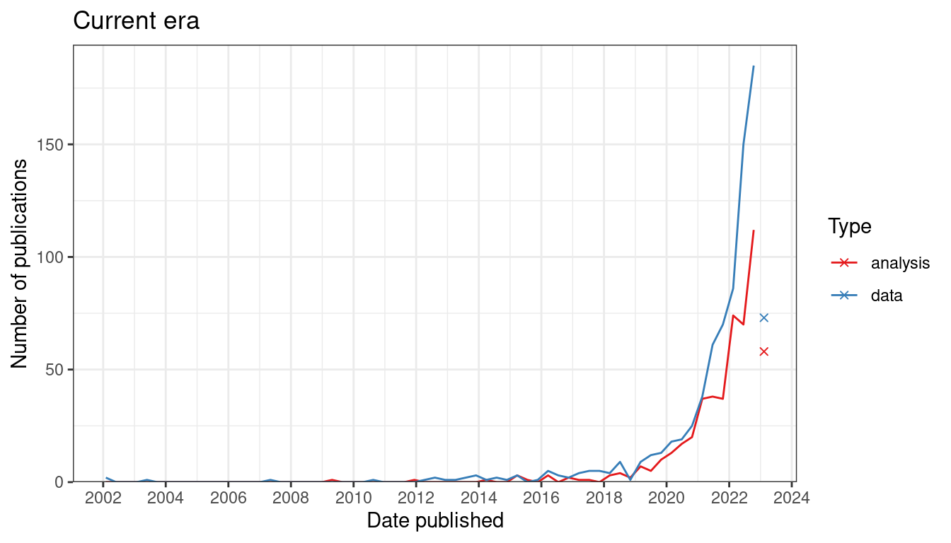
Number of new publications in spatial transcriptomics over time
Reproduced from Museum of Spatial Transcriptomics, Moses and Pachter 2022

Slide 6
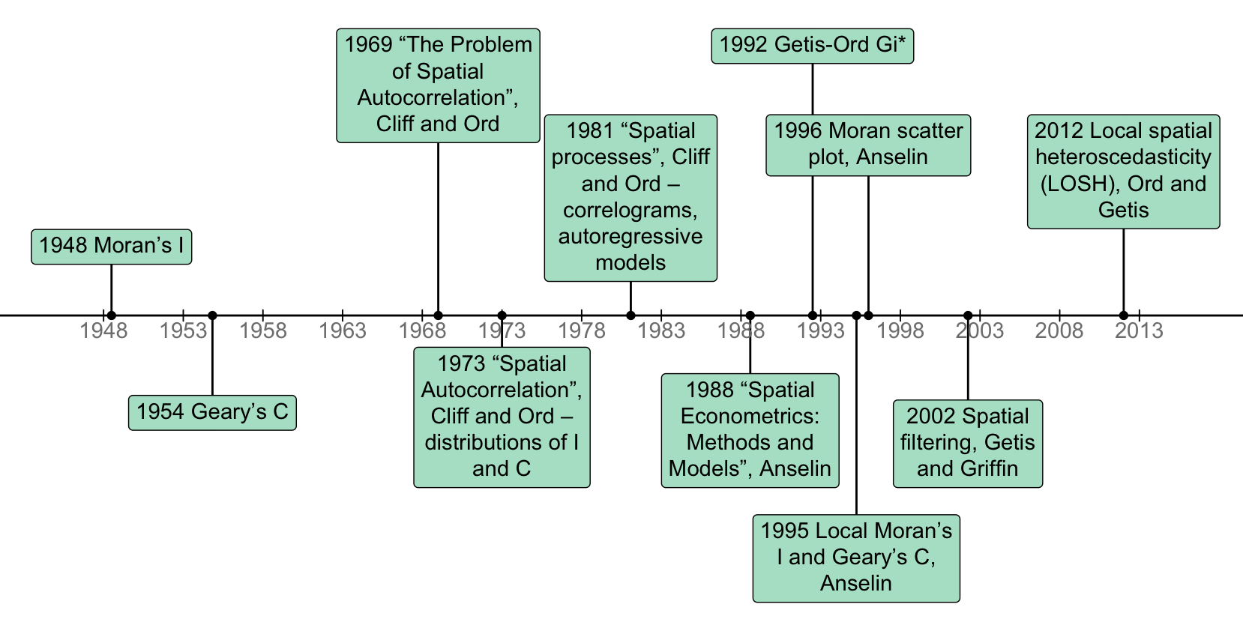
Timeline of spatial statistics in Voyager
Getis, A. (2008), A History of the Concept of Spatial Autocorrelation: A Geographer's Perspective. Geographical Analysis, 40: 297-309. https://doi.org/10.1111/j.1538-4632.2008.00727.x

Slide 7
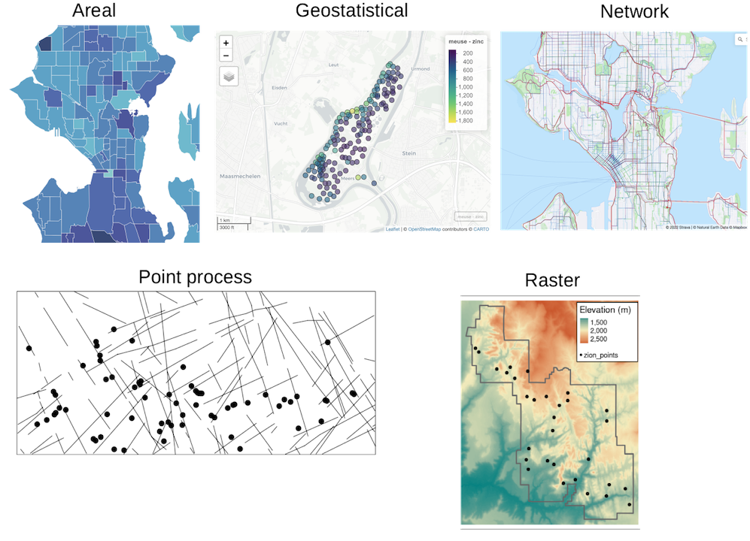
Geospatial data types
Pretend that cells or Visium spots are points,
gstat
Blood vessels, axons, but 3D structure usually lost,
sfnetwork, spatstat
NGS barcoding,
ROI selection
sf, spdep
SFE Voyager
Histology images,
regular grid,
terra
smFISH or ISS transcript spot and cell localization,
spatstat

Slide 8
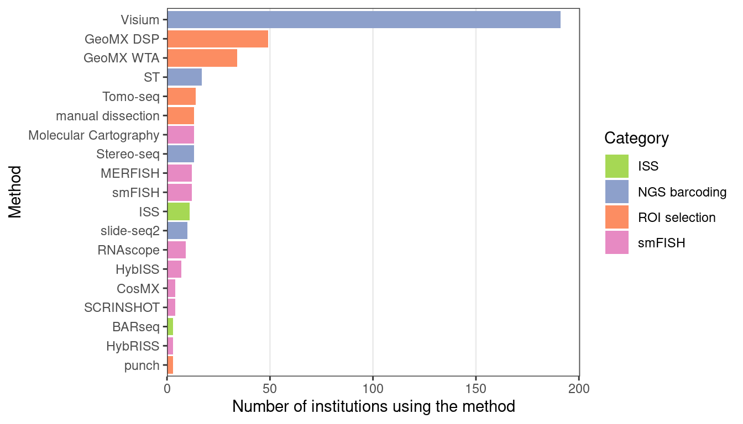
Number of institutions using each current era technology

Slide 9
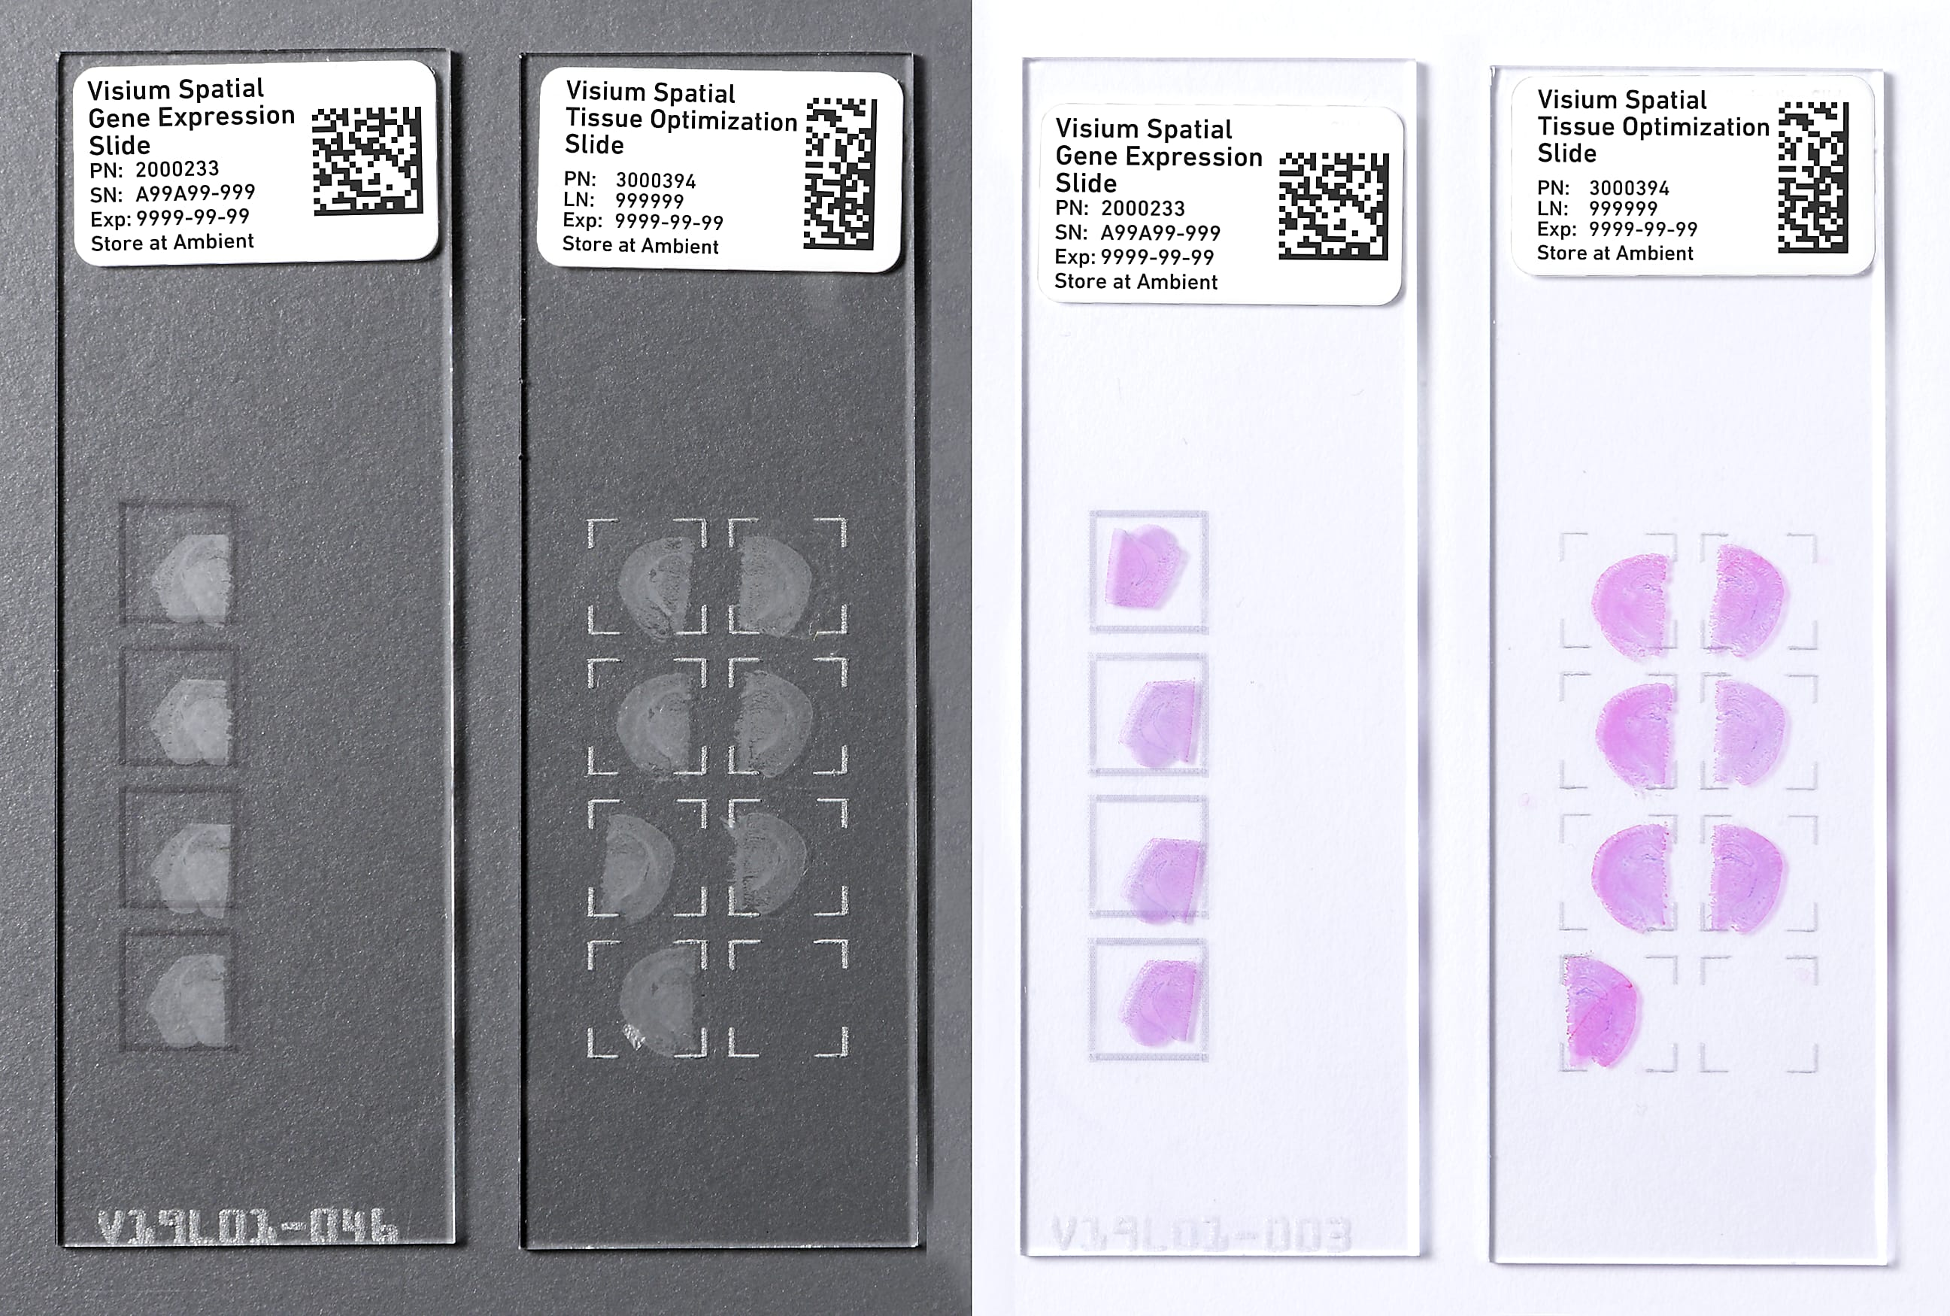
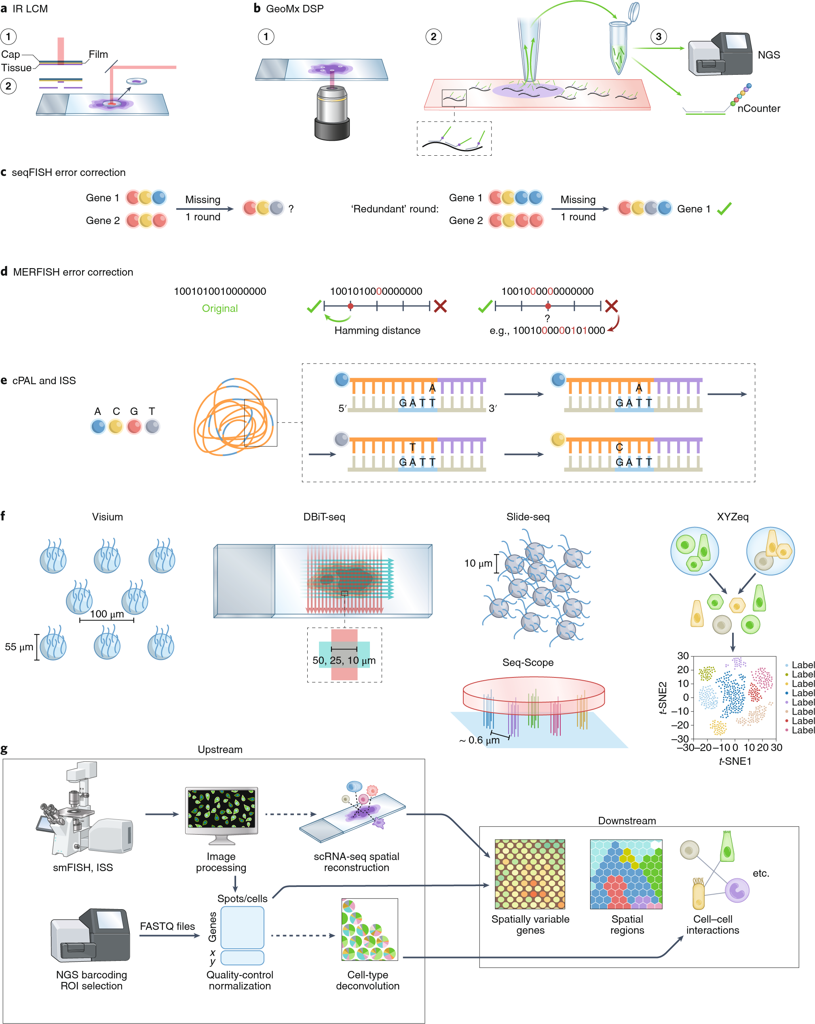

Visium: the most popular NGS barcoding technology
Barcode + UMI + capture sequence
Single cell: 10 μm
10X website
Museum of Spatial Transcriptomics

Slide 10
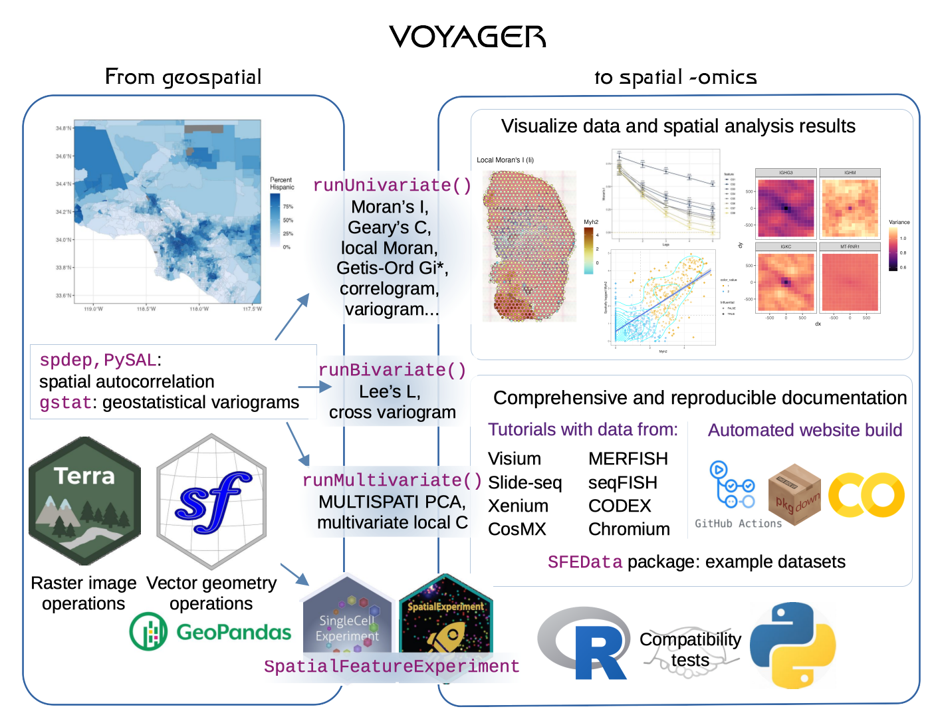


Slide 11
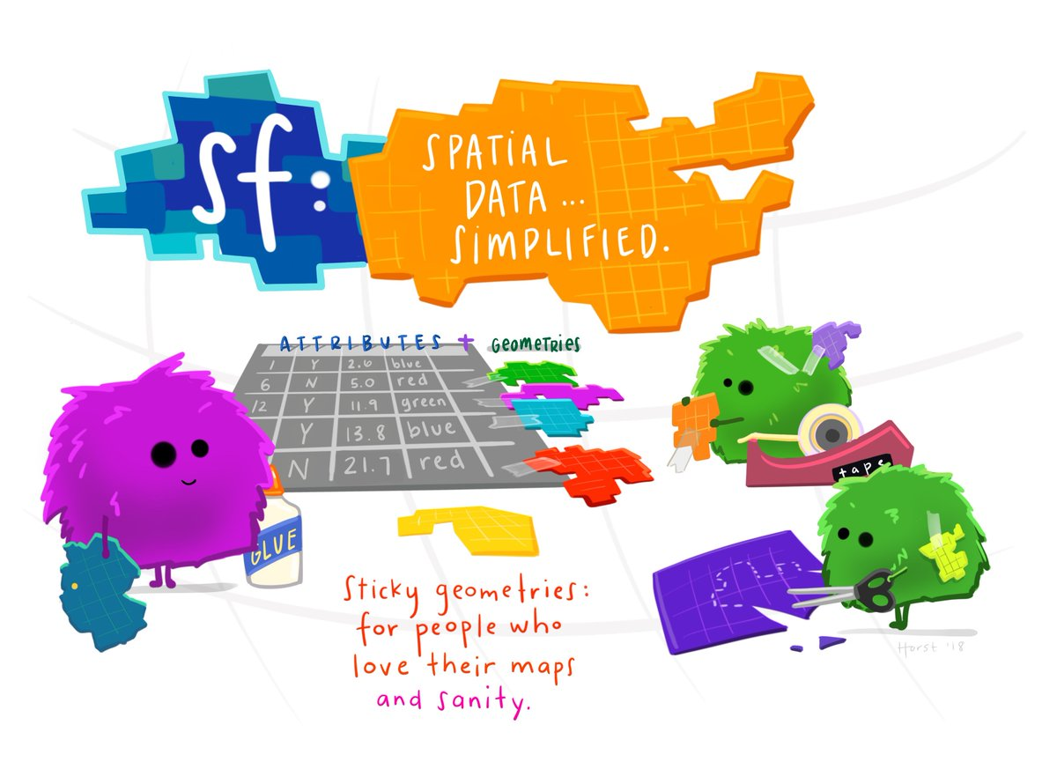
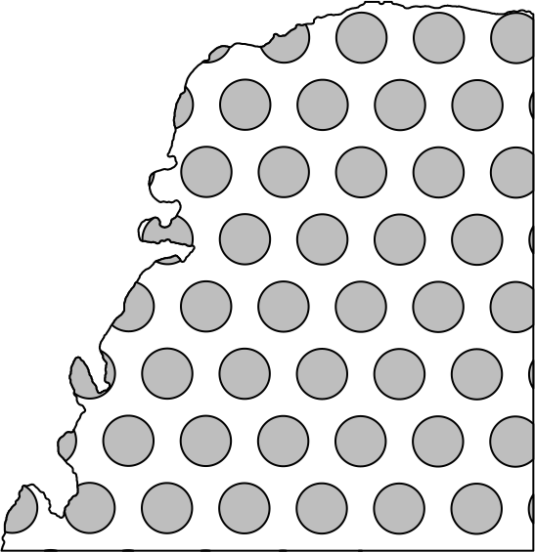
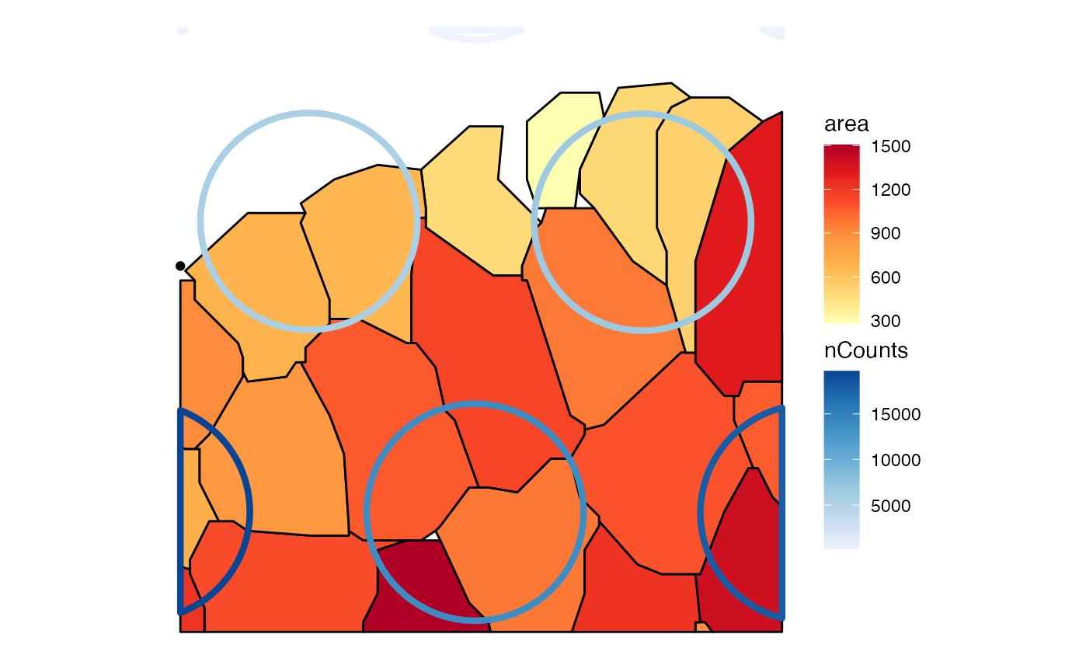
Simple Features: sf R package
Data frame with special column for spatial geometries
GEOS C++ library for fast geometric operations
Whether two geometries intersect
Find the geometry of the intersections
Find cells in each Visium spot
Find cells or spots in each pathologist annotated region
Crop SFE object by polygon
Visualize cell morphology

Slide 12
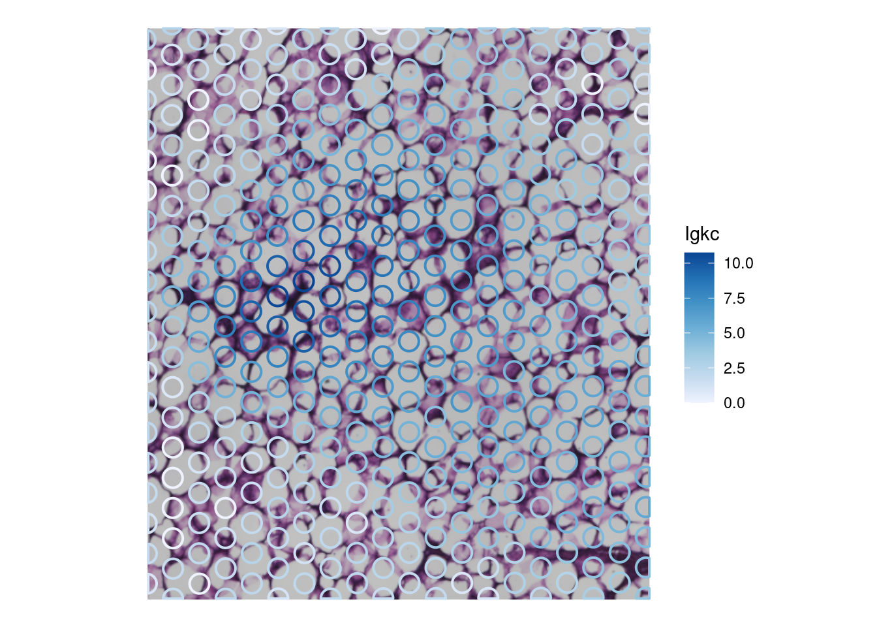
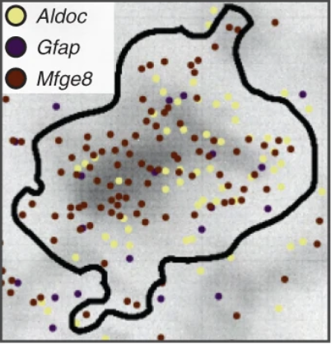
Geometries in biology
Visium spots
Cell boundaries and mRNA molecule spots
Petukhov 2021
Baysor

Slide 13
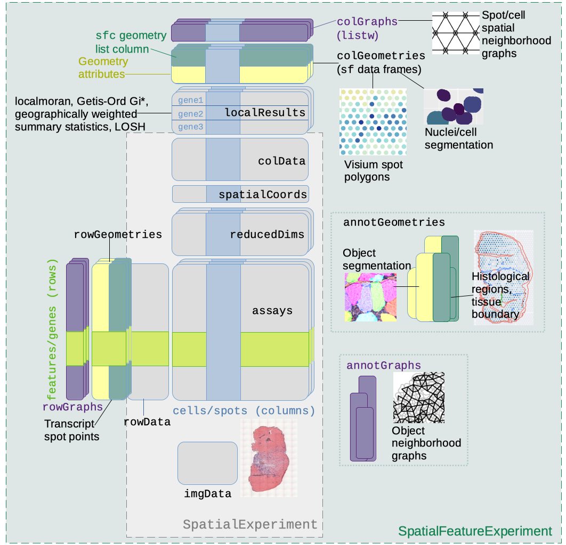
SpatialFeatureExperiment
SpatialExperiment (SPE): Existing package extending SCE for spatial -omics data
SFE: data structure extending SPE with sf
Brings spatial geometries and geometric operations to -omics data for the first time
Voyager: spatial analysis methods (spdep) populating and plotting SFE fields

Slide 14
Exploratory data analysis (EDA)
Voyager to SFE is like scater to SCE and Seurat to SeuratObject
It is important to understand what you CAN DO before you learn to measure how WELL you have seem to DONE it (Exploratory Data Analysis, Tukey 1977)
Exploratory spatial data analysis (ESDA): EDA for spatial aspects of the data, especially spatial autocorrelation

Slide 15
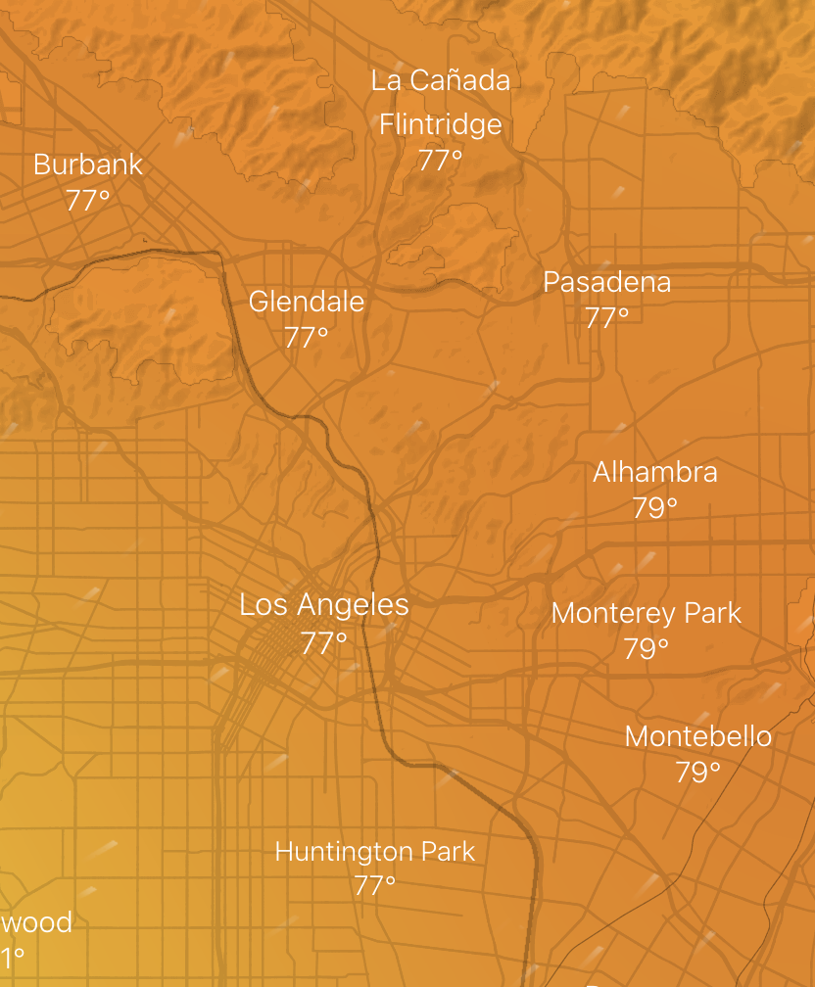
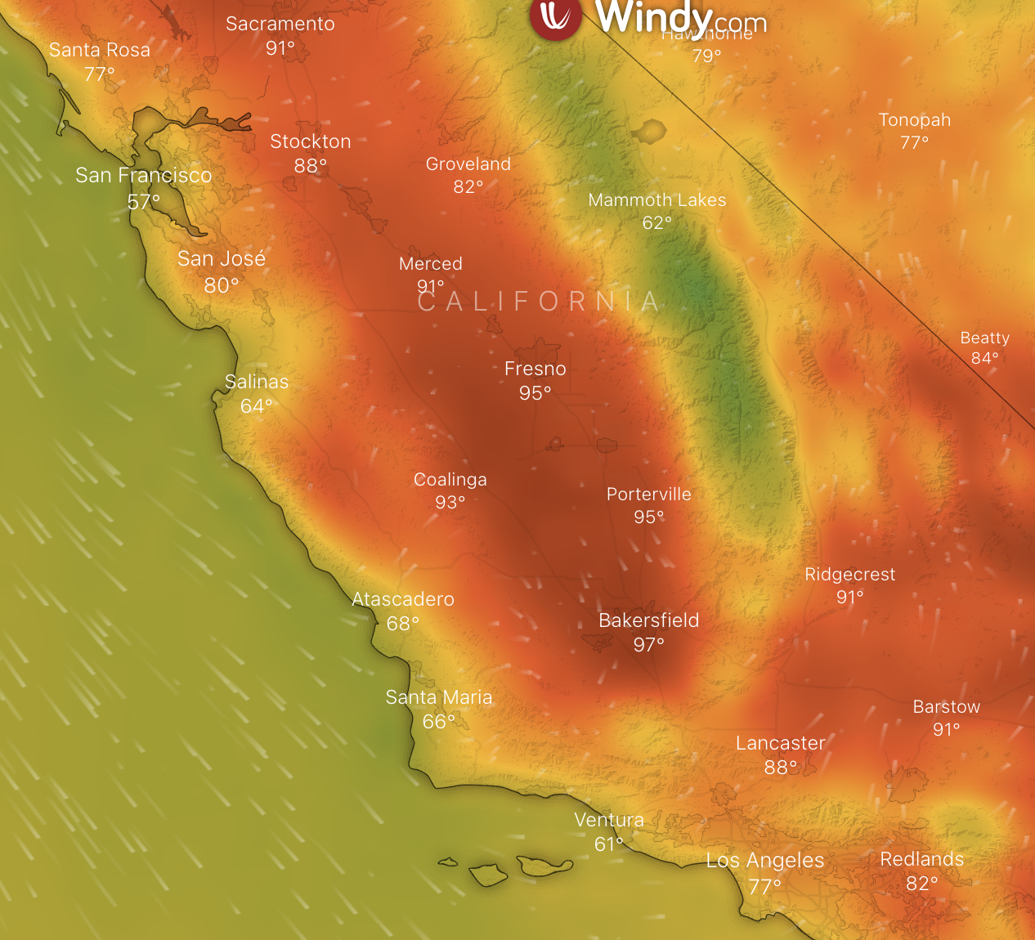

Spatial autocorrelation
Tobler’s first law of geography: Everything is related to everything else. But near things are more related than distant things.
Positive
Negative
windy.com

Slide 16
From geospatial to spatial transcriptomics
Spatial point process: trendsceek, pciSeq, Bento, squidpy, spicyR
Geostatistical (Gaussian process): SpatialDE, SPARK, GPcounts, BOOST-GP, spatialGE
Moran’s I: MERINGUE, Seurat, benchmarking SVG methods
Local Moran’s I: MERINGUE
Lee’s L: MERINGUE, Giotto
Potts model spatial clustering: smfishhmrf (Giotto), BayesSpace
GeoTIFF: samui browser
Existing packages tend to focus on “how WELL you have seem to DONE it”
Voyager: general ESDA (“what you CAN DO”), systematic uniform user interface, more efficient implementations

Slide 18
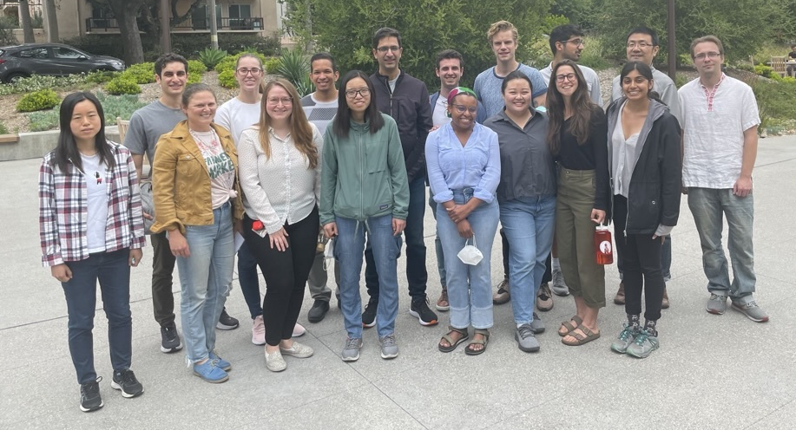
Acknowledgement
Voyager website: Kayla Jackson, Laura Luebbert, Lior Pachter
Python implementation: Sina Booeshaghi, Pétur Helgi Einarsson, Pall Melsted, Sindri Antonsson
Maria Carilli, Delaney Sullivan, Nikhila Swarna, Anne Kil, Charlene Kim, Taleen Dilanyan, and everyone in the lab
Funding: National Institute of Mental Health (NIMH), NIH, Icelandic Research Fund Project

